Slide 1
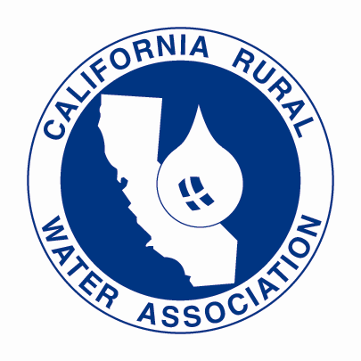
Presentation for Approval
INDIAN WELLS VALLEY GROUNDWATER AUTHORITY
Request For Proposal
California Rural Water Association

Slide 2
CRWA Mission
CRWA Incorporated in 1990, California Rural Water Association (CRWA) has emerged as the State’s leading association dedicated to providing on-site technical assistance and specialized training for rural water and wastewater systems. Tapping into the expertise of experienced water and wastewater professionals, CRWA’s governing Board of Directors, administrative staff, and technical field specialists work in concert to offer CRWA members an expansive range of essential programs and member services.
CRWA is seeking to assist the Indian Wells Valley Groundwater Authority (IWVGA) with proposed assistance in water auditing, leak detection and repairs.
CRWA is the California affiliate of the National Rural water Association, the largest water/wastewater utility membership organization in the nation representing over 28,353 public water and wastewater utilities.

Slide 3
How CRWA may best serve you
CRWA has intimate knowledge of the severity of the Inyokern’s disadvantage communities as it conducted their Median Household Income(MHI) surveying in February of 2019. CRWA has conducted leak detection audits since 2008 and has experience in the Mojave region.
CRWA has developed a Standard Operating Procedure (SOP) for completing Water Audits and Leak Detections for water systems. Our highly trained leak specialist use cutting edge specialized leak detection technology, non-invasive, accurate leak detection. Our association has a positive working relationship with various state agencies such as the State Water Resources Control Board and Department of Water Resources on a multitude of technical services we provide to communities in California.
Our SOP provides information on the services our specialists conduct for both Critical Zone System and Fully System Surveying. Along with our SOP attachment, CRWA has also developed a “Preparations Required” document to be used as a form of coordination and demonstration of communication with water systems our staff services. All operations will be carried out by CRWA trained specialist technical staff using self-provided equipment. All operations conducted are to adhere to our Job Safety Analysis provisions.

Slide 4
CRWA SGMA Staff
Project Personnel
Notes:
Sustainable Groundwater Management Act

Slide 5
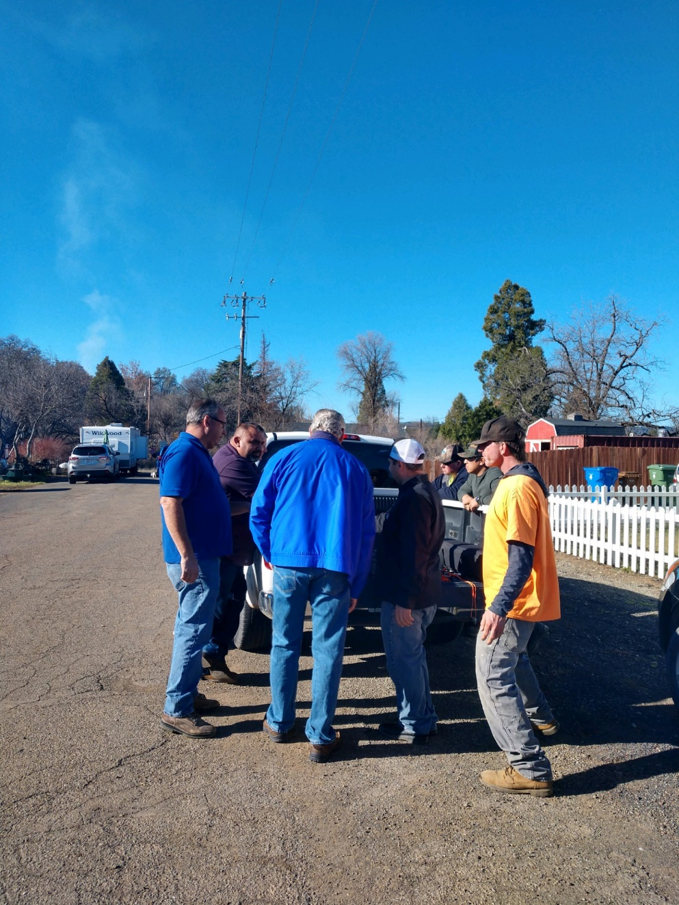
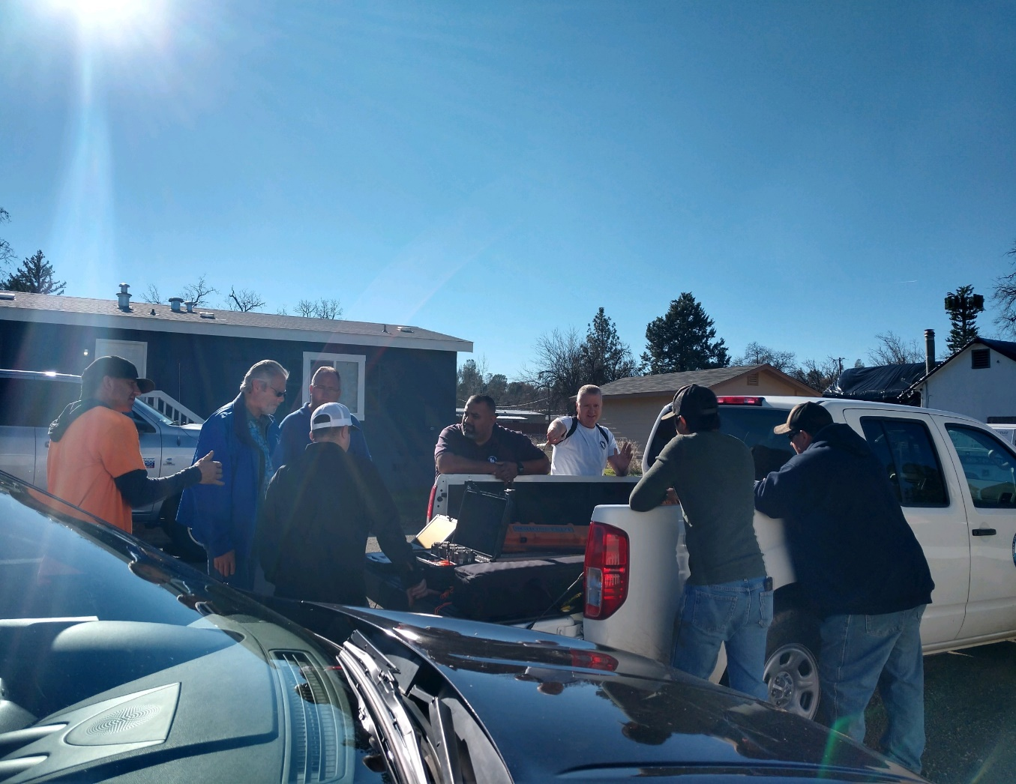
Teaching/Training Operators

Slide 6
Standard Operating Procedure (SOP)
Purpose
Critical Zone System Survey
Water Distribution System-Site specific areas-known for water leaks.
Full System Survey
Water Distribution System-Complete survey of water system.

Slide 7
SOP (continued)
Scope
The purpose of the CRWA Statewide Leak Detection Technical Assistance Program is to provide leak
detection education and technical assistance to small Disadvantaged Communities with limited water
resources.
The proposed CRWA Leak Detection project provides a foundational program on which to build technical expertise in small systems to help reduce existing irrecoverable losses and provide long-term water savings benefits.
CRWA will also provide valuable information and assistance the program to help fix and/or upgrade infrastructure to minimize future water loss.
Leaks are found in old or poorly constructed pipelines, inadequate corrosion protection, poorly maintained
valves and mechanical damage are some of the factors contributing to leakage. Many leaks continue below the surface for long periods of time and remain undetected.
With an aggressive leak detection program, water systems can search for and reduce previously undetected leaks. Water lost after treatment and pressurization, but before delivered for the intended use, is water, money and energy wasted.

Slide 8
Benefits of Leak Detection and Repair
Minimizing leakage in water systems has many benefits for water customers (and their suppliers). These benefits include:
Improved operational efficiency.
Lowered water system operational costs.
Reduced potential for contamination.
Extended life of facilities.
Reduced potential property damage and water system liability.
Reduced water outage events.
Improved public relations.

Slide 9
Prerequisites
Leak Detection / Water Efficiency Specialist (Staff)
Leak Detection Correlators, Acoustic Ground Microphone, Data Loggers, Metal Detector, Line Locators (Equipment)
Class 3 Safety Vest, Boots, 4-Traffic Cones, Survey Sign, Gloves, Safety Glasses, Rain Gear (PPE)
Meter Box Lid Lifter, 2 Metal Clamps, Pry Bar, Hydrant Wrench, 2½” Hydrant Port Pressure Gauge, Measuring Wheel, Hand pump (Tools).
Worksheets, PDF Work Report (Office)

Slide 10
CRWA Responsibilities
Meet with the system operator and discuss systems inventory, system needs, and areas in the distribution system with the highest need for Leak Detection.
Ask operator for:
Maps of system if available. We can also provide assistance in this area with Diamond Maps
How many leaks the system has had in the last year.
How many were Main Leaks and Service Leaks.
What percent of water loss they have from the distribution system?
How they prepare their Water Audit findings.
Would they like to know about water audits and the AWWA Water Audit software.
Do they have any pressure management (VFD’s, PRV’s)? Let them know how pressure management can help reduce system leaks. If they are willing, teach them as much as you can about water loss and leak detection. When in the field preforming leak detection, go through the procedures of the survey from start to finish.

Slide 11
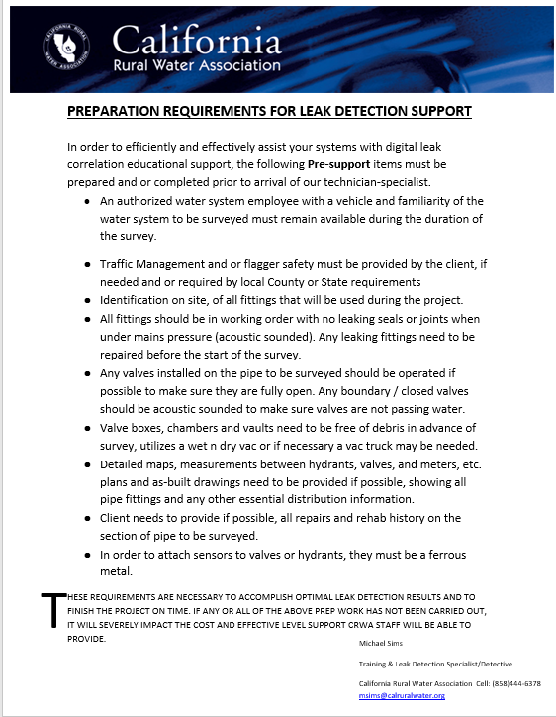
Prep to Water System
Project Manager will email and notified water systems personal for a pre-support check list.

Slide 12
Procedure (Phase 1)
Proceed to the area to be surveyed. Locate fire hydrants, mainline valves, service connections and any other system connections. Look for:
Unusually wet spots in landscaped areas and/or water pooling on the ground surface.
An area that is green, moldy, soft, or mossy surrounded by drier conditions.
Heaving or cracking of paved areas.
Sink holes or potholes.

Slide 13
Procedure (Phase 2)
1) Start with hydrant connections that are under water system pressure. Do not place yourself or any equipment in harm’s way (Heavy vehicle traffic). Be aware of your surroundings looking out for loss dogs or questionable people. Safe guard yourself.
2) If hydrant distances are to great or not available, locate mainline valves for water system connections. Do not place yourself or any equipment in harm’s way (Heavy vehicle traffic)
3) If these distances are to great or not available, locate meter boxes and use metal clamps attaching to curb stop of water system connection. Before opening meter box, look to see if there are bee’s flying in and out of box, and if so do not open meter box. If there are no bee’s tap the top of the box and open slowly. Look inside and check for snakes, scorpions, spiders, roaches, ants, syringes and any other dangers. If any of these things exist move on to another meter box.
4) Measure the distance between correlators. (check measuring wheel has all 4 pins attached to wheel for accurate measurements)
5) Turn on correlator sensors and connect them to the water system (magnetically)
6) Turn on correlator CPU and input water system information

Slide 14
Procedure (Phase 3)
7) Start correlation and observe Central Processing Unit (CPU) graphs. If after the allotted run time of correlation there is no leak found, move on to the next area of the leak detection survey. If the correlation does show an area of concern, measure out the distance in question and determine if there is a running water meter that is in use at that distance. If so than this is what is known as a “Legal Leak” and this accounts for the CPU showing a leak. If no meter is found, then use your line locators (divining rods) to see if any anomaly can be located and if so then make note of anomaly.
The next step is to use the acoustic ground microphone over and in the area in question to determine if there is a leak. If no sounds of a leak can be heard but the CPU is still showing a leak, then we need to run what is called an “Out of Bracket Correlation” to see if the leak is a phantom leak or a confirmed leak. This process places the area of question from being in between the two correlator sensors, to being either to the right of both correlator sensors or to the left of both correlator sensors along the pipe being surveyed
8) A Full System Survey requires all previous procedures plus listening with the
“Ground Microphone” to every: Curb Stop, Fire Hydrant, Blow-Off, Wharf-Head, Air Vacuum Release, Back-Flow Any above ground connection to the Distribution Water System
9) The information for the surveys which is given to the water operator is:
There may be a leak in this general area. We never place an X on the ground stating right here. It’s up to the system operator to evaluate your findings and decide if the evidence from your survey results are overwhelming enough for an excavation.
10) If you have to state, there is a leak: (97%+ sure) You make sure that you can hear the leak from both the “CPU” and from the “Ground Microphone” You need to make sure that all your measurements are as accurate as possible. (Length + Depth) + Correct pipe diameter and pipe material. You give an area that is length x width to location of the leak (example-3ft x 5ft box marking on the ground)

Slide 15
Reporting
Use the leak detection PDF file to report the results of all surveys performed on the water system.
Once completed, send the file to the project manager for review. After reviewed and finalized, save a copy for yourself and send a copy to the water system and one to Resource Development office personnel.

Slide 16
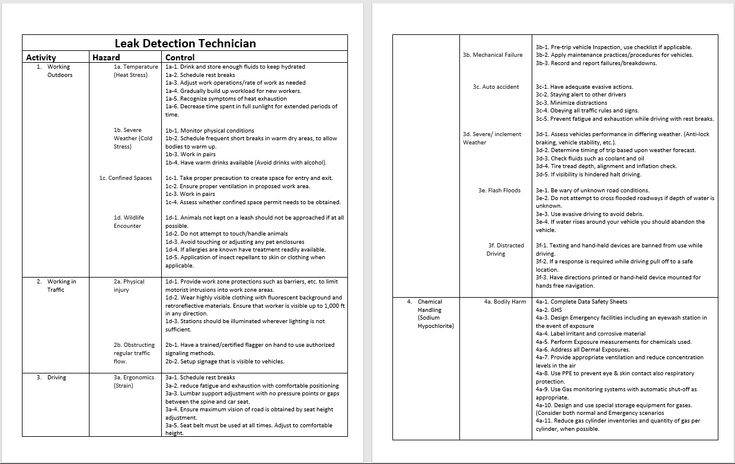
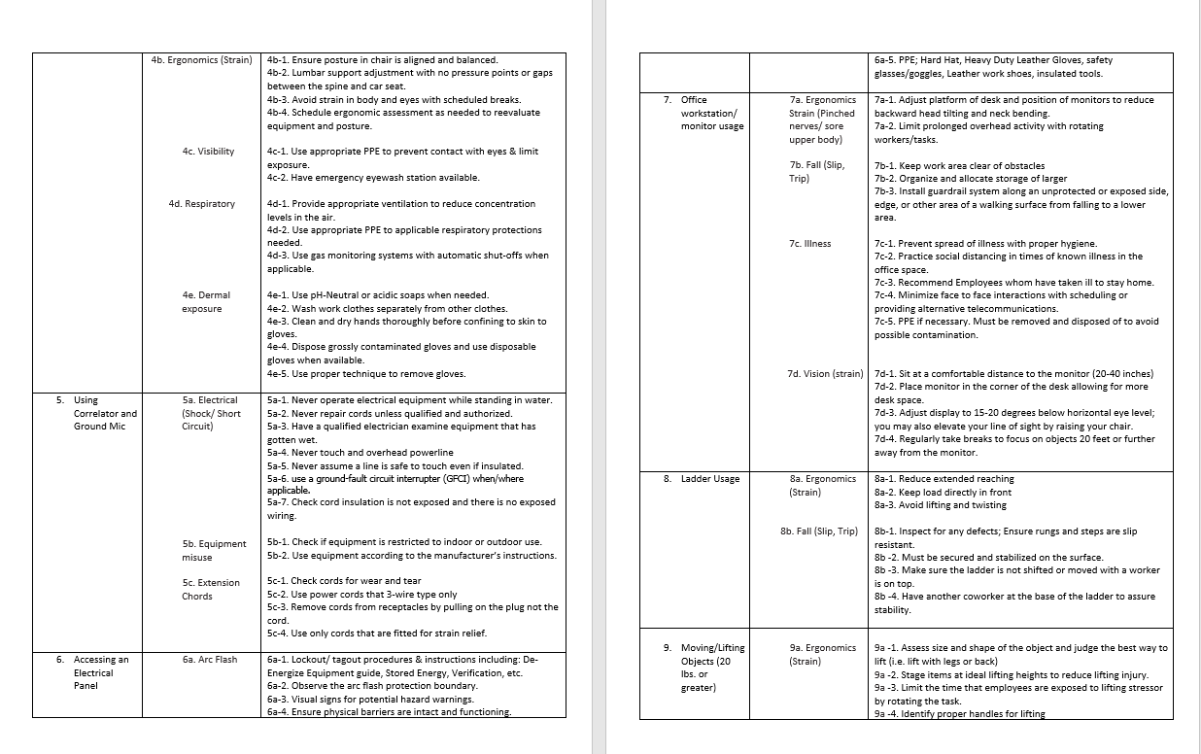
Job Safety practices

Slide 17
Questions & Comments

