Slide 1
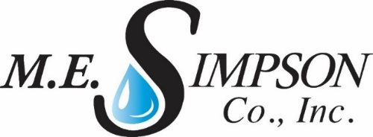
Indian Wells Valley
Groundwater Authority
Water Audit, Leak Detection and Repair Program
Pre-Award Board Interview / Presentation
June 20, 2019

Slide 2
Presentation Outline
M.E. Simpson – Who we are
  Background and Experience
Project Approach and Process
  Water Loss Audits and Validation
  Leak Detection Surveys
Why we will be best to deliver program success

Slide 3
Since 1979…
We offer our clients the highest quality Technical and Professional Services, using state-of-the art technologies and highly skilled, trained professionals.
Services provided across the US
Water Loss Control Audit and Audit Validations
Water Distribution Leak Survey
Large Meter Evaluation and Maintenance
Water Distribution System Valve Assessment
Fire Hydrant Flow Testing & Flushing
GPS Locating and CAD Mapping
Notes:
This is a short list of our most used services we provide.

Slide 4
Water Audit and Leak Detection Project Approach and Proposed Process
First:
Water Systems Study and Evaluation
  Communication with all key stakeholders
  Existing record review
  Utility site visits
Identification of Severely Disadvantaged Communities (SDACs)
Develop Work Plan
  Work closely with IWVGA Project Manager
Develop and Provide Project Outreach (all stakeholders)
Notes:
Make a plan to reduce losses.

Slide 5
Water Audit and Leak Detection Project Approach and Proposed Process – cont.
For each system:
Water Audits – Perform and Review
Review Water Supply Data
Review Authorized Consumption
Calculate Apparent Loss
Calculate Real Loss
Review Performance Indicators
Notes:
Make a plan to reduce losses.

Slide 6
Water Audit and Leak Detection Project Approach and Proposed Process – cont.
For each system:
Leak Detection and Repair Service
Review Calculated Real Loss from Audits
Review maps of each system
Perform Leak Detection Survey
Classify Leaks by severity
Facilitate leak repairs using local contractors
Notes:
Make a plan to reduce losses.

Slide 7
Water Audits:
How Can the Top-Down Water Audit Help Each Utility?
Identifies potentially deficient areas within the utility
Shows the need to implement the use of benchmarks or performance indicators
Asks the question “Where in our system are we losing water (and/or revenue)?”
Asks “How can we minimize the losses?”
Determines value of lost water
Can increase utility financial standing
Notes:
Why perform an Audit?

Slide 8
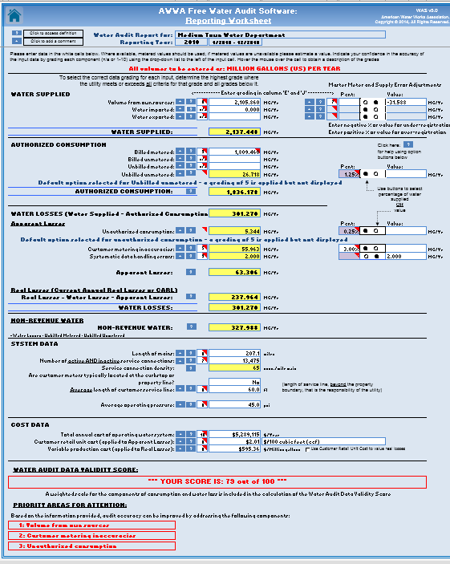
AWWA Water Audit
Water Supplied
Authorized Consumption
Water Losses
Apparent
Real
Non-Revenue Water
System Data
Cost Data
Validity Score
Priority Areas for Attention
Notes:
Water Audit Spreadsheet ver. 5

Slide 9

Non-Revenue Water
Unaccounted-for-Water Non-Revenue Water (NRW) =
Real Losses
Apparent Losses
Unbilled Authorized
Consumption
Source
Distribution Network
Customer Meter
Residence
Transmission Main
WTP
Reservoir
Source Meter
Inaccuracy
Theft
Notes:
Locate the Non-Revenue Water so Utility can reduce costs.

Slide 10
Each Completed Audit with Identify the Standard Water Balance
Start here
Move this direction
Water
Exported
Authorized
Consumption
Total
System
Input
(allow
for
known
errors)
Authorized
Consumption
Billed
Authorized
Consumption
Revenue
Water
Billed Water Exported
Own
Sources
Total
System
Input
( allow
for
known
errors )
Water
Exported
Water
Supplied
Billed Metered Consumption
Water
Supplied
Billed Unmetered Consumption
Unbilled
Authorized
Consumption
Non-
Revenue
Water
Unbilled Metered Consumption
Water
Imported
Unbilled Unmetered Consumption
Water
Losses
Water
Losses
Apparent
Losses
Unauthorized Consumption
Customer Metering & Data Inaccuracies
Real
Losses
Leakage on Mains
Leakage on Service Lines
(before the meter)
Leakage & Overflows at Storage
Notes:
Start on the left… move right. This will show where the water is going.

Slide 11
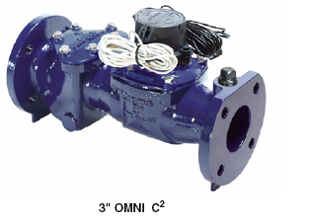
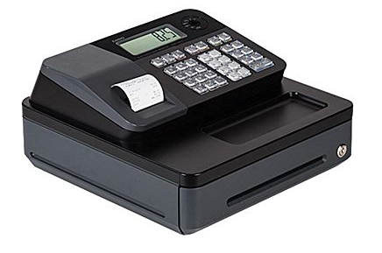
“4 Pillars” of Apparent Loss Management
NRW Management Team:
Billing
Meter Reading
Customer Services
Revenue Water
Field Services
System Development
IT
Meter = Cash register
=
Notes:
Controlling Apparent Losses are made up of 4 concepts.

Slide 12
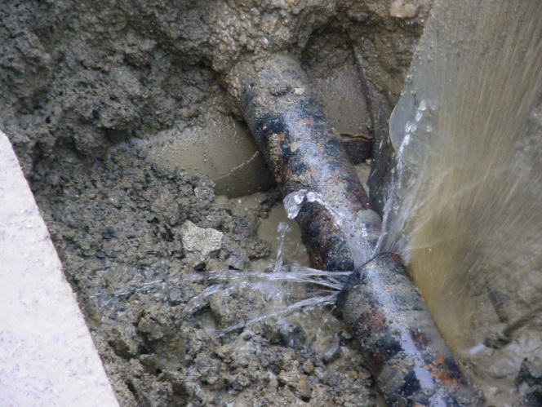
“4 Pillars” of Real Loss Management
NRW Management Team:
Distribution
Field Services
Leak Survey
Leak Repair
SCADA
Engineering
Revenue Water
Notes:
Controlling Real Losses are made up of 4 concepts as well.

Slide 13
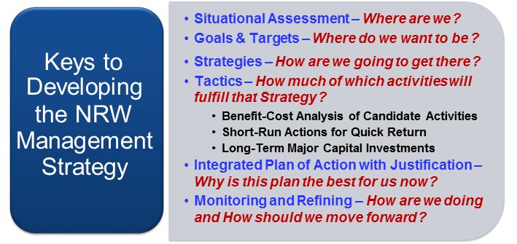
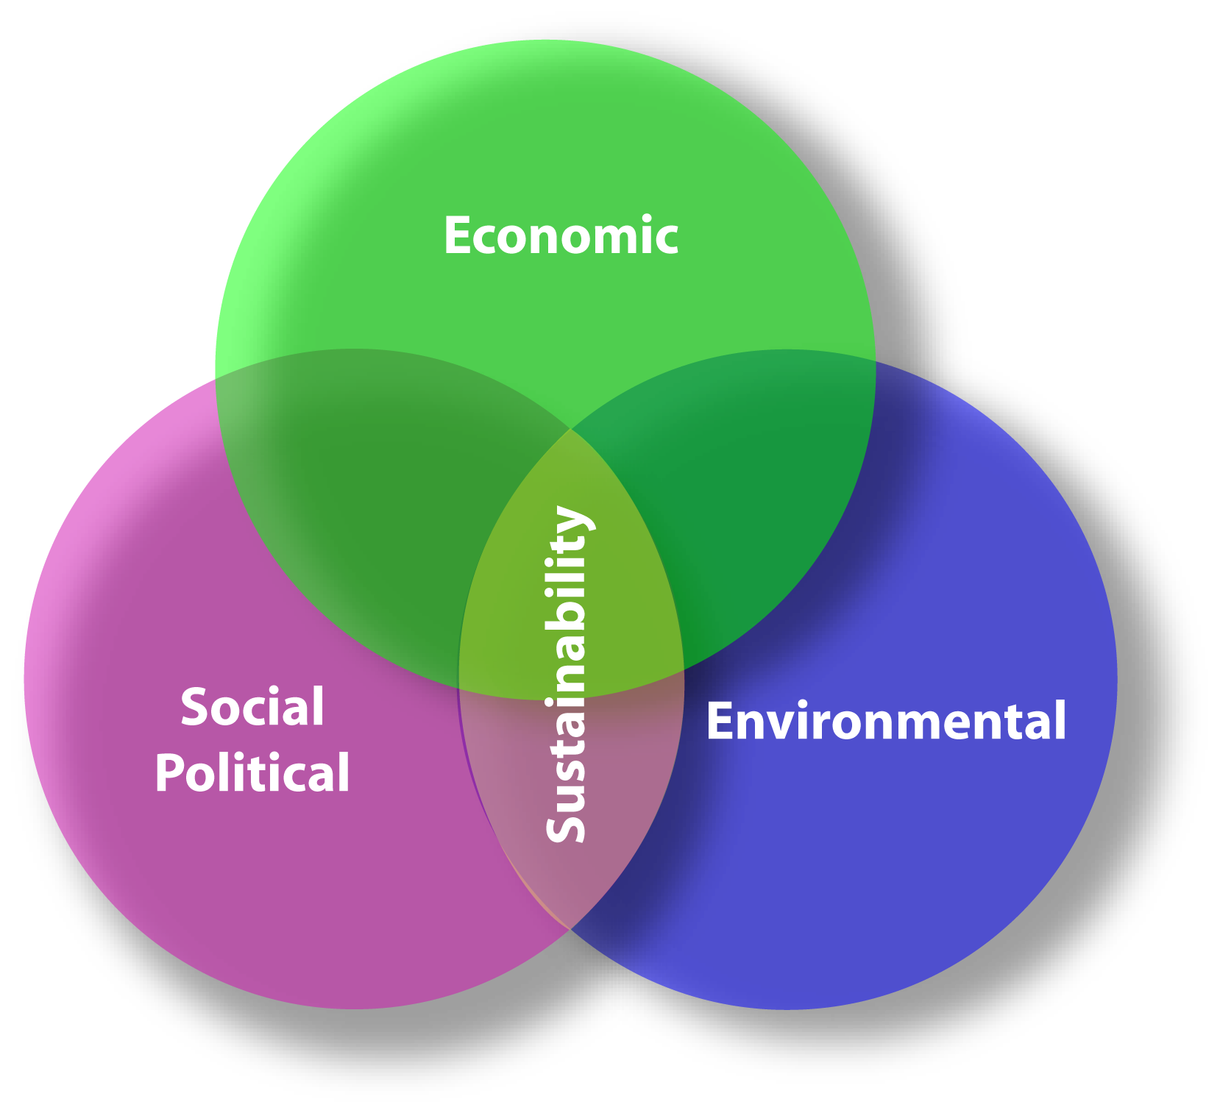
After the audit… Overview of Strategy Development
NRW Management
Triple Bottom Line
Notes:
Make sure the Loss Reduction Strategy includes these three considerations.

Slide 14
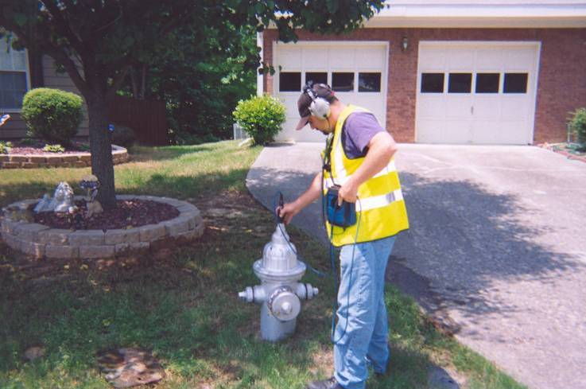
Leak Detection and Repair
We will Utilize Appropriate Acoustic Leak Detection
Leak Surveys – All Identified SDACs
Fluid escaping a pipe under pressure produces “Leak Noise”
Leaks are detectable based on:
  Size of leak
  Pressure of pipe
  Pipe size
  Pipe material
  Length of pipe between listening points
  Good physical contact with pipe or valve

Slide 15
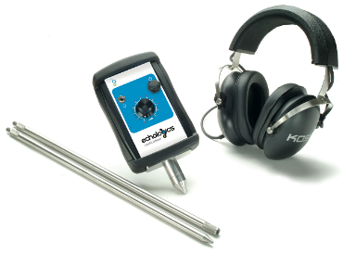
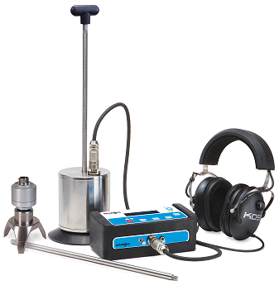
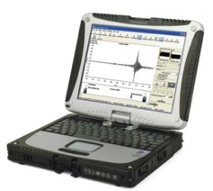
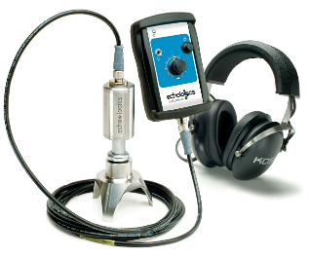
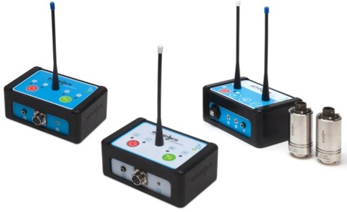
Our Tools of the Trade
Listening Devices
Leak noise correlator
Notes:
Here is a sampling of different equipment (another plug for the demonstration if to be held with the workshop). Overnight correlators can be left in the field so staff does not have to be on site when background noise is less of an issue.

Slide 16
Why Select M.E Simpson Co. Inc
We are:
Seasoned, Professional Water Utility Service providers
Experienced, “hands-on”, successful managers and technicians
Dedicated to assist our clients with achieving their Water Loss Assessment initiatives cost-effectively with exceptional value.
Know, understand and respect the impact that Water Loss Assessment initiative decisions have upon the Utility, customers, and community.
Driven to ensure the Utility has the critical information necessary to make sound, time-tested, customer-focused solutions regarding the Water Loss Control program.
Notes:
16
Why you should select our team!

Slide 17


Any Questions?

