Slide 1

Indian Wells Valley Groundwater Authority Water Audit, Leak Detection and Repair Program
June 20, 2019
Ashan McNeally, P.E., Program Manager
Carl Sharkey, Water Loss Advisor
Kingsley Blease, P.E., Water Audit Consultant
Pam Malone-Webster, Client Manager

Slide 2
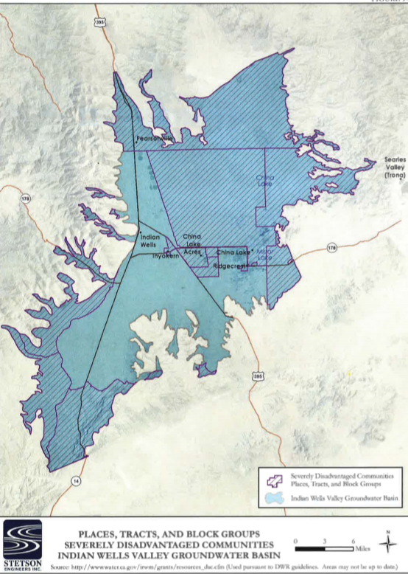

Program Goals and Benefits for IWVGA
Implement requirements of the Sustainable Groundwater Management Act (SGMA)
Benefit Severely Disadvantaged Communities (SDACs)
Protect Groundwater Basin and water supply
Identify and quantify metering inaccuracies or failures
Reduce and Control Water Loss from pipe leakage, meters, theft
Preserve and Protect/Repair Assets; and limited resources

Slide 3

Our Background and Experience
40+ AWWA M36 Water Audits Completed
17K+ Miles of Pipe Surveyed
7k+ Leaks Pinpointed
3M+ Meters Analyzed
30+ Years of Pipeline Management Experience
500+ engineers, scientists, technicians
15 offices in North America

Slide 4

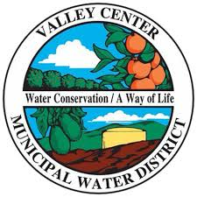
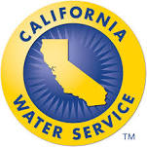
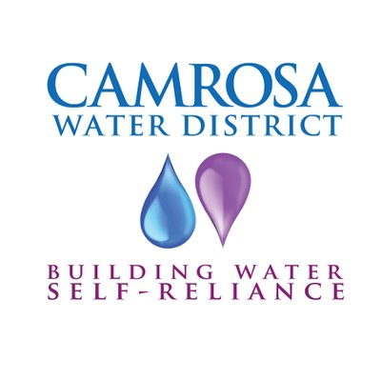


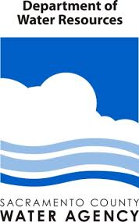





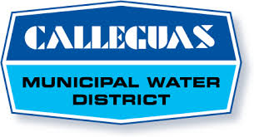


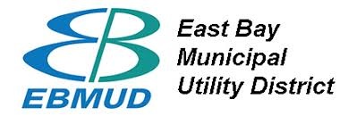



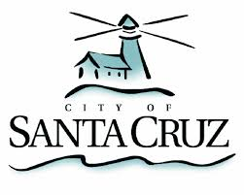



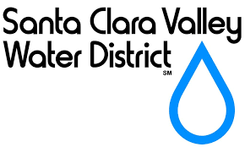

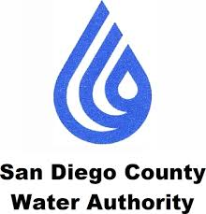



Projects & Programs
Notes:
Water Audit and Leak Detection Programs

Slide 5
Phase I: AWWA Water Audit Approach
Helps to quantify water volumes
Into system - Flowmeter accuracy
Out of system
  Customer sales (meter accuracy : under-registration; plus reading and billing system errors)
  Utility water use (not much metered)
– Leakage (unknown)
Completed Annually
Best Management Practices
NRW identification and reduction program

Slide 6
Discovery and Water Audit
Discovery
Gather and review SDACs information
Meet SDACs to establish availability of data
Develop workplan in collaboration with IWVGA, including number of water audits.
Review workplan with SDACs/IWVGA, including outreach, communication and coordination with SDACs
Water Audit
Complete water audits as described in following slides

Slide 7
Water Audit Methodology
Gather data using audit questionnaire (based on 40 audits since 2006) – volumes into and out of system, type and age of meters, meter accuracy testing results
Develop spreadsheets of gathered data – calculations, assumptions, estimates
Enter data into software – AWWA current version 5.0
Analyze results, compare performance indicators with industry values
Develop program for NRW identification and reduction
Implementation – measures to reduce NRW

Slide 8
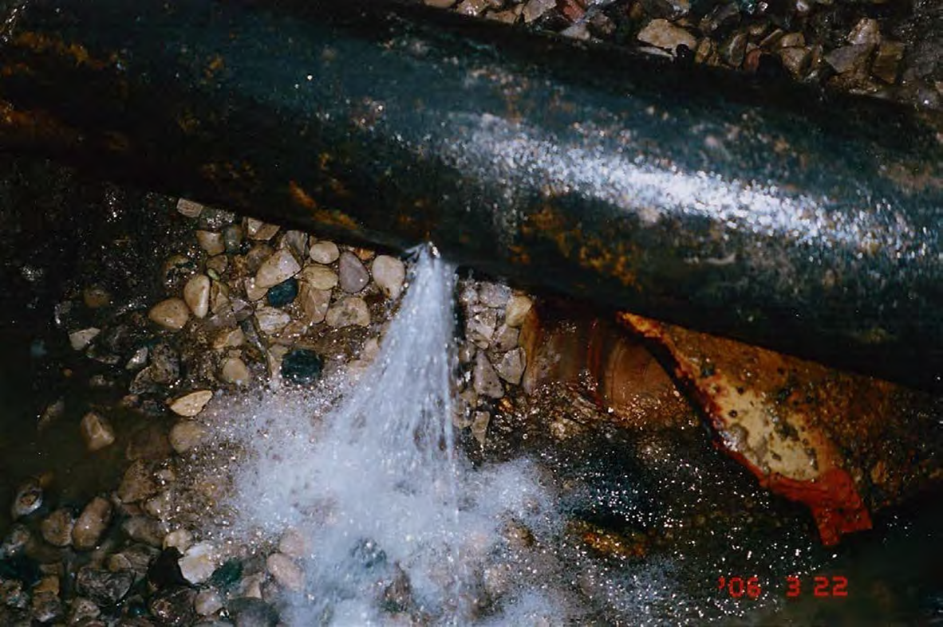
Identify Real Water Losses
Unreported Leaks (not surfacing)

Slide 9
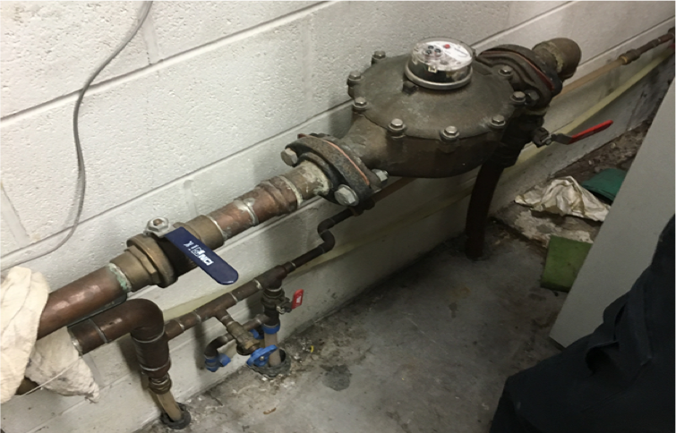
Identify Apparent Water Losses - Metering Inaccuracies

Slide 10
Valor Water Analytics
Problem
Apparent losses impact water and financial sustainability
Average of 2% of top-line revenue is lost annually via apparent loss issues
Water balance calculation uncertainty due to unknown metering inaccuracies
Solution
Uses meter data to identify apparent losses in system
Locates meter under registration, leaks, data errors and unauthorized consumption
Locates issues on up to 5% of meters to recover 1.5% top line revenue, annually.
Empowers proactive revenue recovery and operational efficiency

Slide 11
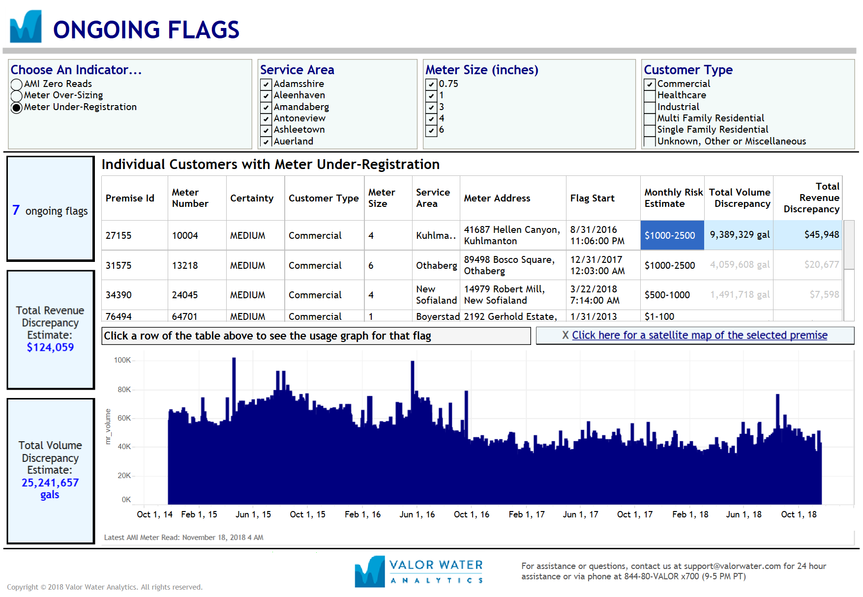
Dashboard
Demo dashboard: portal.valorwater.com
Username: demo_training
Password: Uw+Jk9F4K2

Slide 12



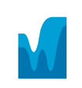




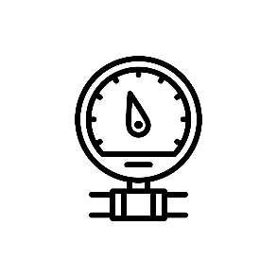

Valor Revolutionizes How Water Agencies Work
We use machine learning and analytics to inform operational interventions to transform how water utilities operate.
Data Inputs
Outputs
Machine learning/AI
Intuitive Dashboards
Historic and current meter and billing data
Industry Intelligence
Operational Interventions
Revenue Recovery
Operational Efficiency
Informed Operators

Slide 13
Hidden Revenue Locator
METER AGE AND THROUGHPUT
DEGRADATION CURVE
4-10X ROI OF TRADITIONAL METER REPLACEMENT / TESTING PROGRAMS
WATER QUALITY
SCALED CONSUMPTION
LEARNING/ RE-LEARNING

Slide 14
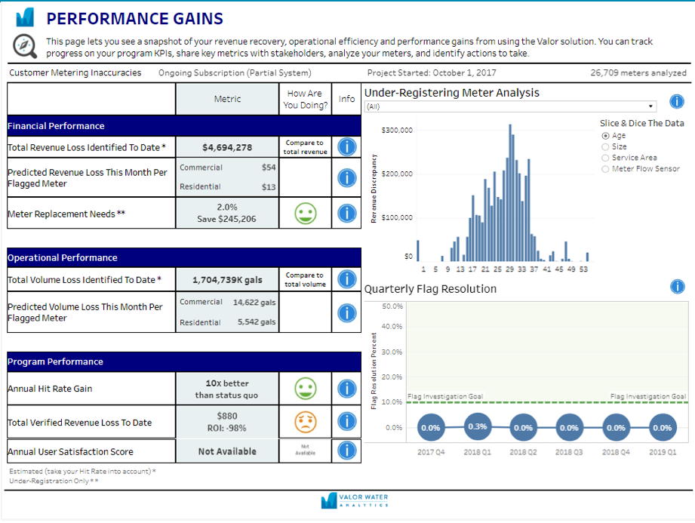
Measuring Delivery Program Performance

Slide 15
Representative ROIs from 8 Clients
Utility Size (# meters)
Top Line Rev.
Increase
Utility Net ROI
% of Revenue
Utility 1
Utility 2
Utility 3
Utility 4
Utility 5
Utility 6
Utility 7
Utility 8
149,260
47,261
58,529
104,428
76,157
88,350
73,963
155,487
$262,234
$474,216
$1,465,618
$225,239
$4,402,504
$860,715
$1,408,856
$1,338,480
0.5%
1.2%
3.4%
0.8%
6.8%
1.4%
1.9%
2.8%
59%
334%
835%
72%
1,927%
325%
635%
443%
Average: $16.77 per meter per year

Slide 16
Valor Water Analytics
Provide economic justification for all meter replacements
Prioritize meter replacement program – dynamic list updated monthly
Optimize operational resources – focused actions on only flagged meters
Revenue protection – reduce apparent losses as part of Non Revenue Water program

Slide 17
Phase II – Leak Detection and Repair Approach

Slide 18
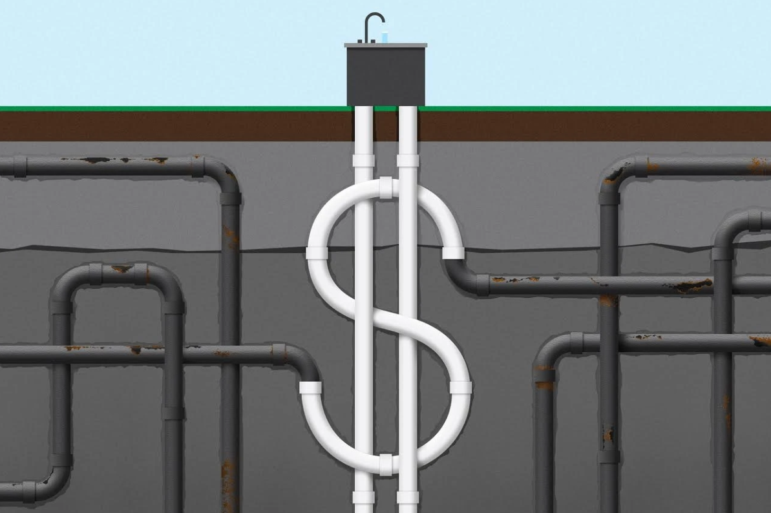
Phase II: Leak Detection and Repair Approach
Phase II: Field Implementation
Leak Management
Leak Surveys & Pinpointing
  Conventional external leak technologies
  “Lift & shift” using noise loggers & hydrophones
  Internal acoustic technologies
Establish virtual DMA’s
Pressure optimization
Critical main condition assessment

Slide 19
External Leak Detection Process
Survey
Pinpoint
Verify
Repair
Asset Inventory

Slide 20
Leak Detection Activities
Hold a Safety meeting
Provide appropriate traffic control and safety measures
Locate starting asset to begin survey
Listen to assets to identify audible leaks
  If no leak sound heard, move to the next identified asset in the leak detection survey.
  If a leak sound is heard, identify other nearby assets to narrow the leak location point (valves/meter boxes, etc.)
  Begin correlation between the two (2) assets with highest audible sound of suspect leak
  Place correlator sensors on two (2) identified assets (this is in areas where metallic pipe is known)
On the control box, enter all the known information (distance, pipe material, etc.)
Begin correlation
Map location of leak and assets used to correlate
Return the work area to its original state and/or repair

Slide 21
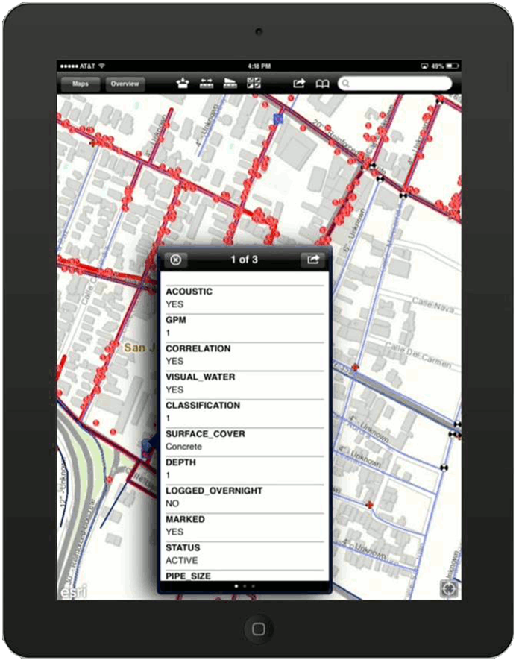
Asset Data Capture
Project Tracker
Data is captured for every survey point and can be viewed by clicking on each one.

Slide 22
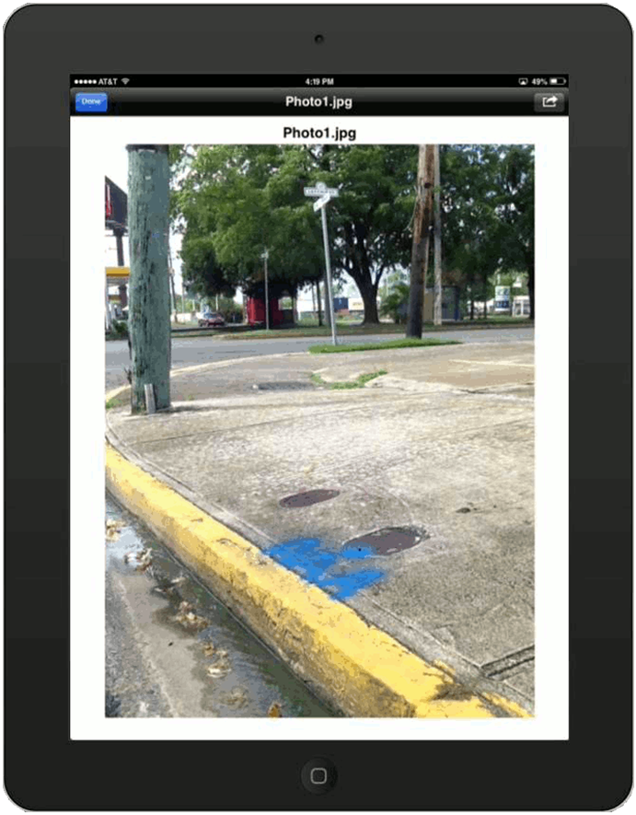
Asset Data Capture
Project Tracker
A photograph can be attached to each documented leak as a reference point for repair crews.

Slide 23
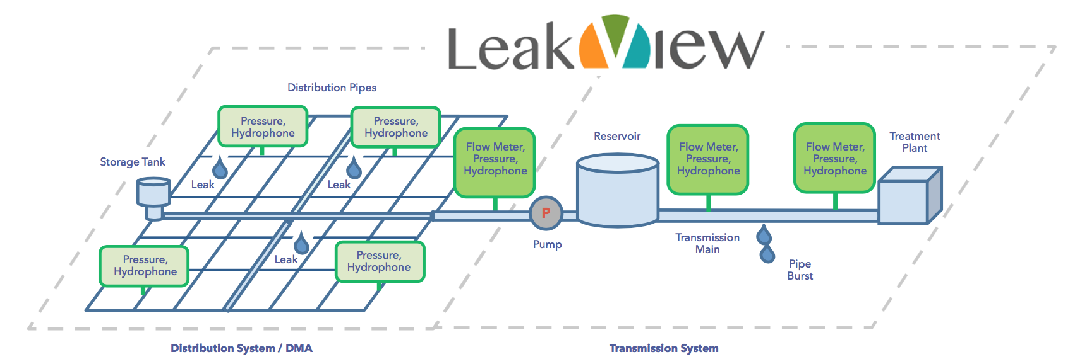
Innovative Leak Detection Approach
Smart Meters
Leak detection, localization, and notification

Slide 24
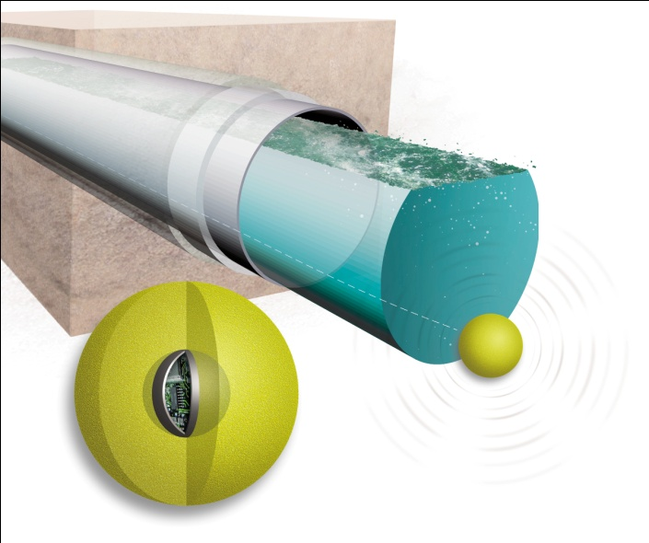
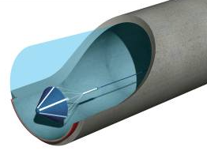
In-line Leak Detection
SmartBall
Sahara
    Locates leaks & air pockets in transmission mains
    X and Y mapping helps understand pipeline alignment
    Used in pipeline diameters 8” and higher

Slide 25
IWVGA’s Water Audit, Leak Detection Repair Program
Keys to
Success
Experienced
Program Team
Actionable Information
Sustainable and scalable
Industry leading solutions

Slide 26
Questions?

