Slide 1
Introductions
Started with landscape & irrigation training
Licensed C-27 Contractor
Founded in 2001
Thousands of audits conducted

Slide 2
Experience & Certifications
History:
Over 18 years in landscaping/horticulture/rebate programs
Over 100 combined years of staff experience
Over 100 water agencies and municipalities
Service area includes: California, Arizona, and Washington
Licenses and Certifications:
CSLB C-27 (978574)
Certified Landscape Irrigation Auditor (CLIA)
Certified Landscape Irrigation Auditor - DRIP
Qualified Water Efficient Landscaper (QWEL)
Certified Irrigation Technician (CIT)
D1 (Distribution) Certified
Certified Water Manager (CLCA)
Certified Contractor for Department of Industrial Relations (DIR)

Slide 3
Services
Experience:
Managed San Diego County Water Authority’s Sustainable Landscape Replacement Program – Processed over 2,000 rebates from 2012-2019
Managed City of Ventura’s Turf Replacement Program – Processed over 1,000 rebates from 2015 to Present
Managed Santa Clara Valley Water District’s Landscape Rebate Program– Processed over 1,000 rebates from 2009 to 2012
Distributed and installed over 65,000 High-Efficient Toilets
Conducted over 10,000 device inspections for numerous agencies including Metropolitan Water District of Southern California
Conducted over 55,000 Residential Water Surveys
Conducted over 10,000 Commercial and Large Landscape Surveys

Slide 4
Services
What We Offer (Rebate Administration):
Full Turn-Key Approach
Administrative support available Monday through Friday 9 AM – 5PM our toll-free number, fax and email.
A webpage where customers can apply online to participate and view information about the products that are included in the program. Customers can also apply via, fax or email if they need assistance
Assistance in marketing, PR, and Outreach, if necessary
Able to carefully approve and deny customers rebates
Provide pre and post inspections
Issue customer checks, receive W9 and issue 1099

Slide 5
Services
What We Offer (Direct Install):
Full Turn-Key Approach
Administrative support available Monday through Friday 9 AM – 5PM our toll-free number, fax and email.
A webpage where customers can apply online to participate and view information about the products that are included in the program. Customers can also apply via, fax or email if they need assistance
Assistance in marketing, PR, and Outreach, if necessary
Provide pre and post inspections
Manage Contractor to store products and verify products are being installed correctly
Provide Department of Industrial Relations (DIR) reporting if necessary

Slide 6
Services
What We Offer (Optional Approach):
Administrative support available Monday through Friday 9 AM – 5PM our toll-free number, fax and email
A webpage where customers and contractors can apply online to participate and view information about the products that are included in the program. Applications can also be submitted via, fax or email if they need assistance
Assistance in marketing, PR, and Outreach, if necessary
Encourage local contractors to participate and short list contractors
Provide rebates directly to contractors (WaterWise would not install, only manage the program)
Provide pre and post inspections on contractors work
May avoid DIR reporting and higher costs.

Slide 7
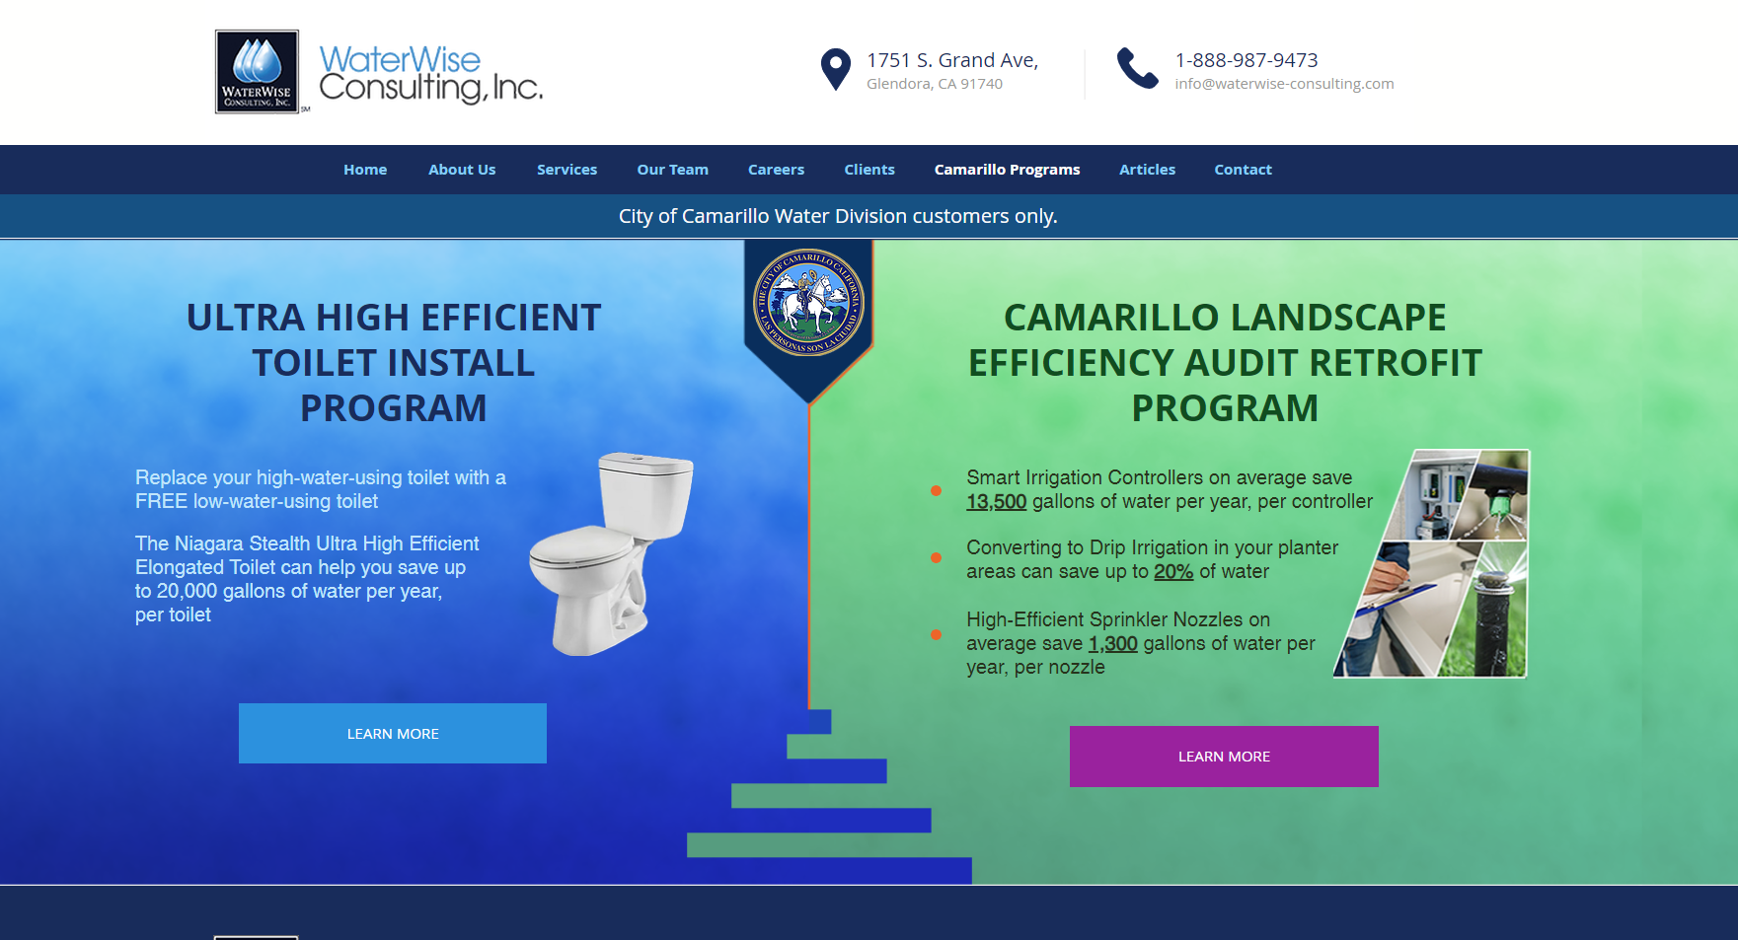
Examples
Web Portal – www.waterwise-consulting.com/camarillo

Slide 8
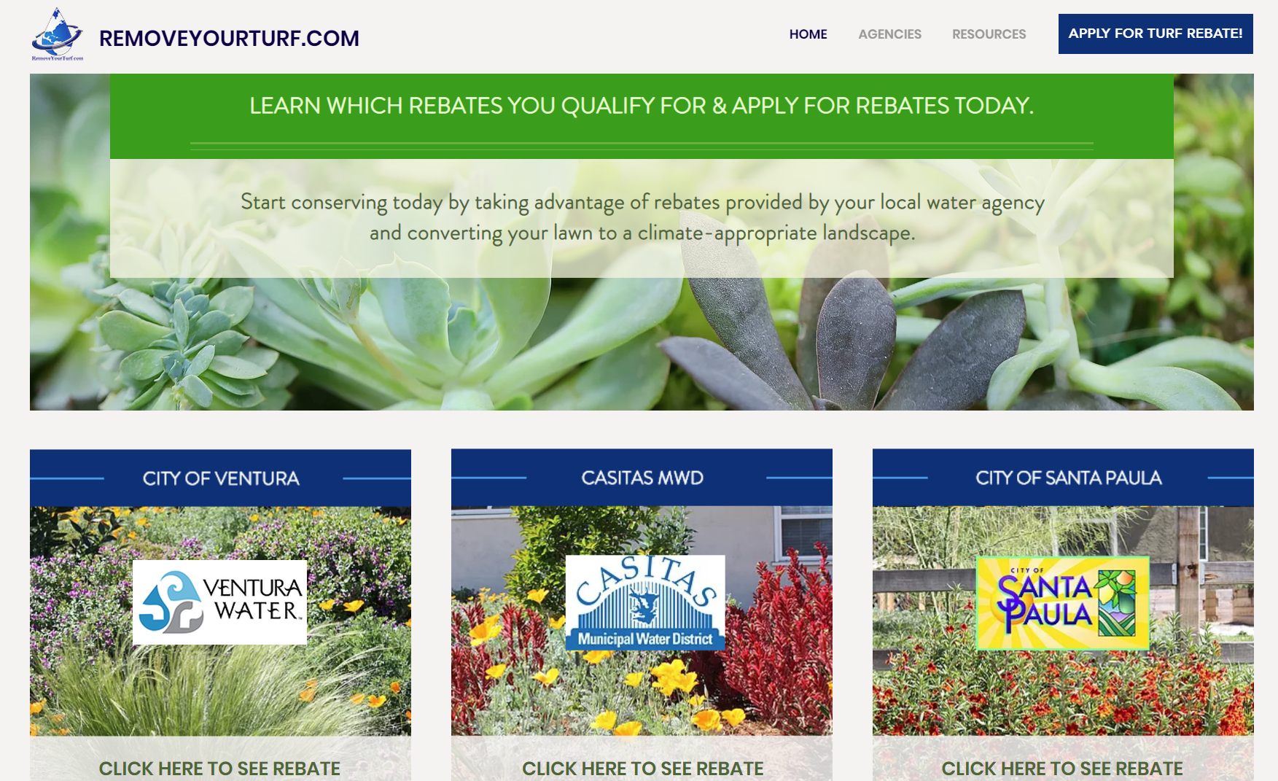
Examples
Web Portal – www.removeyourturf.com

Slide 9
Questions?
Thank You For Your Time!

