Slide 1
Urban Community Drought Relief Grant
IWVGA Shallow Well System Consolidation Project
IWVGA Board Meeting: 4/10/24

Slide 2
General Grant Info
WRM briefing on Consolidation
Purpose
  Mitigate impacts to shallow wells caused by the chronic lowering of groundwater levels, degraded water quality, and reduction of groundwater in storage by consolidating small water systems with shallow wells into the larger public water system.
  Provide more secure water source for residents with wells at risk
Term of Agreement:7/1/2022 (start of cost accounting)
Execution Date: 1/16/2024
Work Completion Date: 12/31/2026
Grant Amount: $3,345,000

Slide 3
Grant Budget Categories and Schedule
CATEGORY | Budget | Start Date | End Date
CATEGORY A – PROJECT ADMINISTRATION Task 1 – Project Management Task 2 - Reporting | $445,000.00 | 7/1/2022 | 12/31/2026
CATEGORY B – LAND PURCHASE/EASEMENT Task 3 – Land Purchase | $100,000.00 | 7/1/2023 | 9/1/2026
CATEGORY C – PLANNING/ DESIGN/ ENGINEERING/ ENVIRONMENTAL DOCUMENTATION Task 4 –Feasibility Studies Task 5 – CEQA Documentation Task 6 - Permitting Task 7 - Design Task 8 – Project Monitoring Plan | $500,000.00 | 7/1/2022 | 6/30/2026
CATEGORY D – CONSTRUCTION/IMPLENTATION Task 9 – Contract Service Task 10 – Construction Administration Task 11 - Construction | $2,300,000.00 | 1/1/2024 | 10/31/2026
TOTAL COSTS | $3,345,000.00

Slide 4
Deliverables
CATEGORY | Deliverables
CATEGORY A – PROJECT ADMINISTRATION
Task 1 – Project Management Task 2 - Reporting | Invoice and associated backup documentation Quarterly Progress Reports, grant completion report, documentation
CATEGORY B – LAND PURCHASE/EASEMENT
Task 3 – Land Purchase | All relevant documentation regarding acquisition of easement.
CATEGORY C – PLANNING/ DESIGN/ ENGINEERING/ ENVIRONMENTAL DOCUMENTATION
Task 4 –Feasibility Studies Task 5 – CEQA Documentation Task 6 - Permitting Task 7 - Design Task 8 – Project Monitoring Plan | Feasibility Studies All completed CEQA documents Permits Required 100% Design Plans and Specification Project Monitoring Plan
CATEGORY D – CONSTRUCTION/IMPLENTATION
Task 9 – Contract Service Task 10 – Construction Administration Task 11 - Construction | Bid Doc, Proof of Ad, Award of Contract, NTP DWR Certification of Project Completion and Record Drawings Photographic Documentation of Progress

Slide 5


Indian Wells Valley Water District
Celebrating more than 60 Years of Service
www.iwvwd.com
Consolidation Update
Renee Morquecho, Ph.D., P.E.: Chief Engineer

Slide 6
IWVWD Proposed Consolidations
Dune 3 Consolidation
China Lake Acres
37 connections
Operations and maintenance challenges
Est. cost $3.6M – 3300 L.F. 12-inch main and 8500 L.F. of 8-inch main plus hydrants, meters and new connections.
Two wells that will be destroyed following consolidation

Slide 7
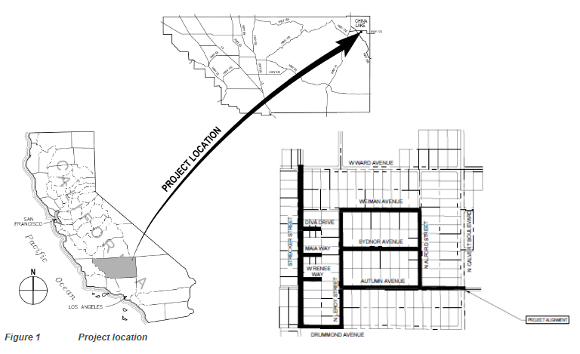
IWVWD Proposed Consolidations
Dune 3 Consolidation Overview

Slide 8
IWVWD Proposed Consolidations
Hometown Water Association
  12 connections
  One well
  Operation and maintenance issues
  Aging system and not enough storage
  Est. $270,000 project using District forces

Slide 9
Potential Consolidations
State Water Resources Control Board Division of Drinking Water (DDW) Recommended Consolidations*
  Dune III Mutual Water Company
    Already in the process of consolidation
      ~$3.6 million project cost
  China Lake Acres Mutual Water Company
  Buttermilk Acres Water System
  Hometown Water Association
    Already in process of consolidation
      ~$270,000 project cost
  Sierra Breeze Mutual Water Company
  *Listed as systems DDW would like to see annexed by Indian Wells Valley Water District (IWVWD) in the IWVWD Domestic Water System 2020 Water General Plan
Shallow Wells
  Stark
    Well failure due to low groundwater levels
  Byerly
    Well failure due to low groundwater levels
  Halpin
    Well failure due to low groundwater levels
  Rademacher
    Water quality issues
  Heritage Village
    Well failure due to low groundwater levels

Slide 10
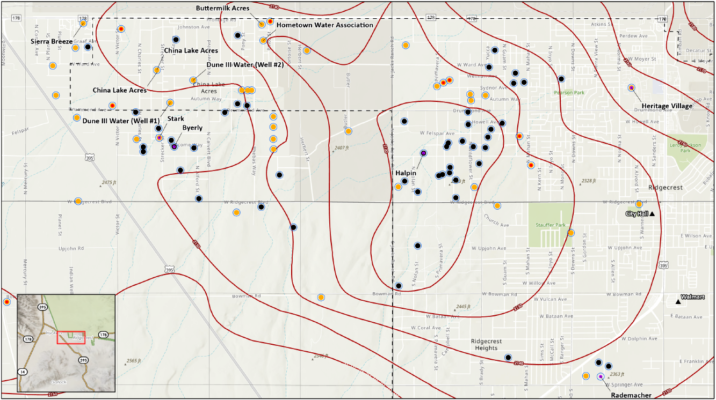
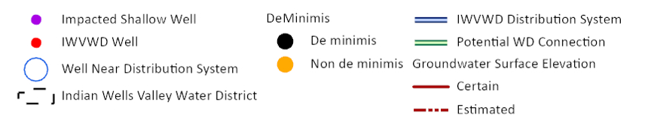

Potential Consolidations
2130
2120
2140
2150
2120
2130
2140
2150

Slide 11
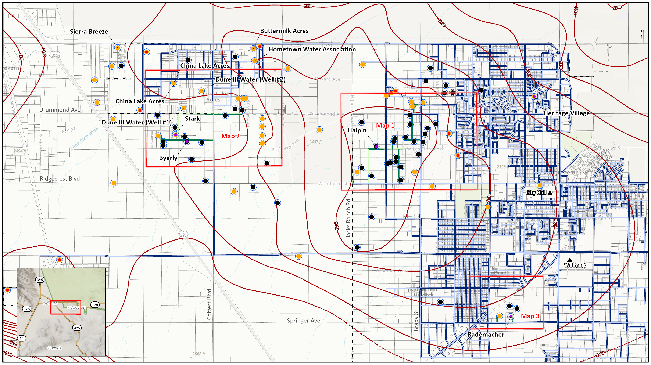
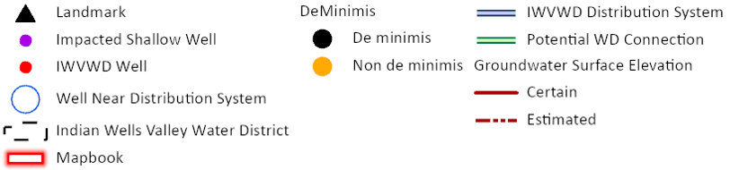
Potential Consolidations

Slide 12
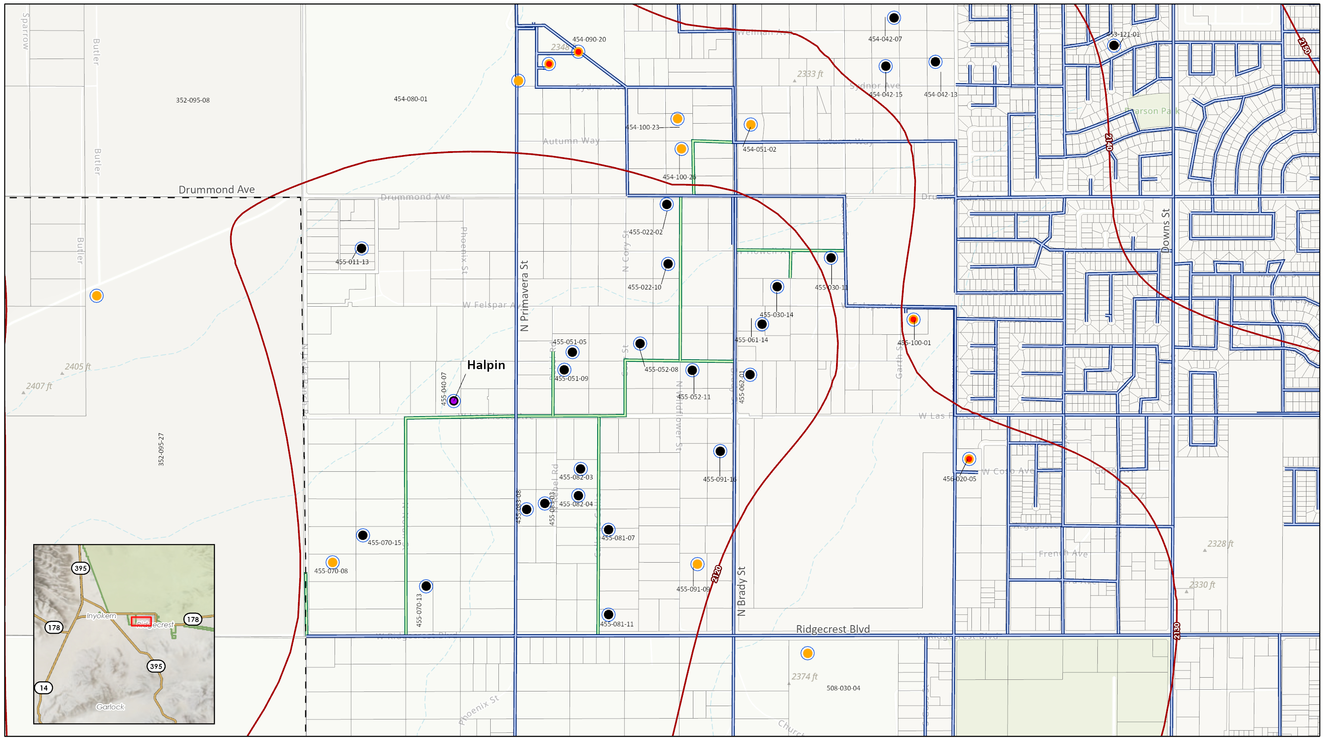
Potential Consolidations
Kathleen Moe
IWVWD
Patricia Hudson
Mark Mercer
IWVWD
Ken Amster
Donald Quist
IAC Water Co op
IAC Water Co op
Larry Schiller
2120
2130
Michele Newton
2140
Kelly Ayers
Edward Jeter
SVM
Gary Cartmell
John O’Gara
IWVWD
Hubert Drake
Mark Lambert
Ronald Smith
Halpin
Paul Decker
Harlan Kooima
David Saint-Amand
Helen Jackson
IWVWD
Robert Westbrook
2120
William Borns
Orvis Powers
2130
Bill Corley
Bob Pyke
Donald Blachly
CHLT Water Group
John Freeman
Nolcrest North Water Company (Eugene Vejtasa)
Michael Aley
SVM
2120

Slide 13
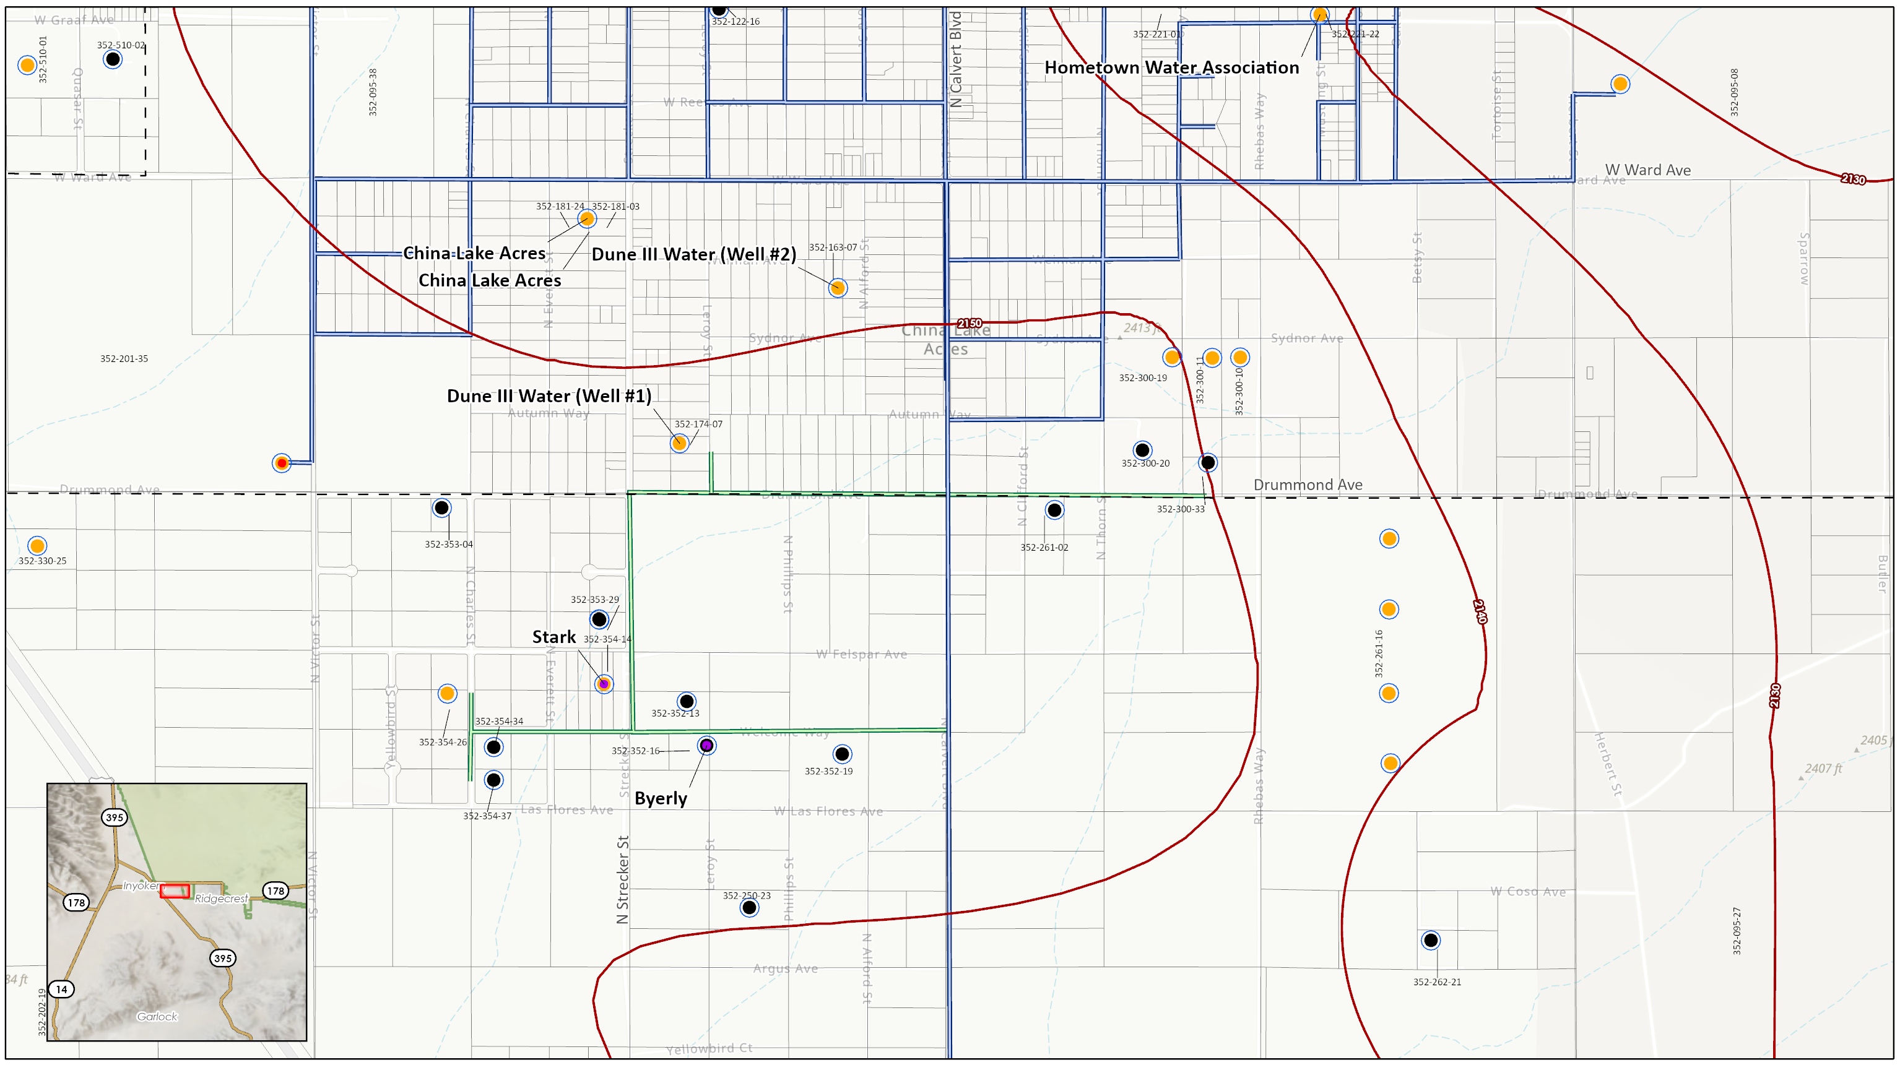

Potential Consolidations
Larry Williams
Paul von Schlemmer
Amber Glow Ranch
SVM
2150
2130
2140
2130
Donald Quist
IWVWD
Donald Quist
James Baldwin
Dixie Water Well Association
Eric Bengston
Oasis Water Company
Donald Quist
Elizabeth Walsten
Mike West
Donald Quist
Stark
Yellowbird Water Co op
Mark Decker
Donald Quist
Kristi Cole-Smith
James Murray
Donald Quist
Kristi Cole-Smith
Byerly
Carol Schneider
2150
2130
James Lloyd
2140

Slide 14
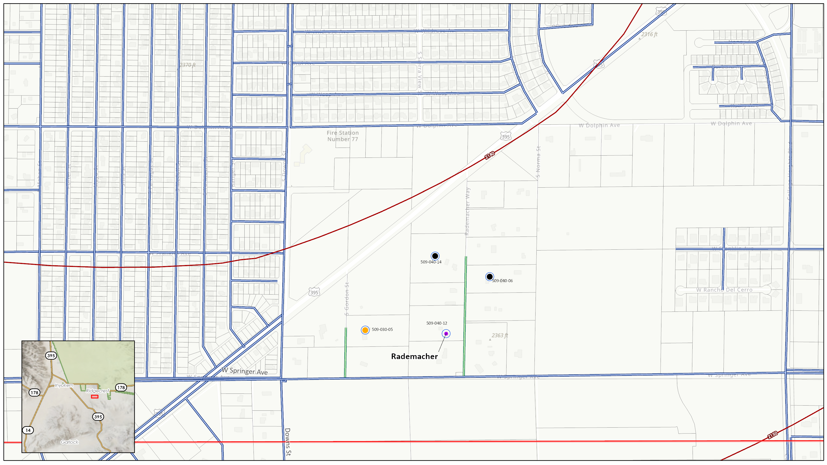
Potential Consolidations
2140
Robert Brown
Bradley Grover
Desert Sands Mutual Water Co op
Rademacher
2150

Slide 15
FAQs
What are the next steps?
  A coordination meeting has been scheduled and held with the IWVWD. We are working on actual and potential projects identifications and prioritization.
Can the Grant funds be used to help fund the Water District’s current consolidation projects?
  Grant funds could potentially fund a portion the Water District’s current consolidation projects for work done on public land.
Is this Grant only for “reimbursement” of costs?
  There are provisions for “advanced Grant funding”, however, a demonstration must be provided showing “cash flow” issues and a clearly defined project.
How will the GA consolidation projects be identified and prioritized?
  The GA staff will preliminarily identify and prioritize consolidation projects. These potential projects will be reviewed by the TAC before being acted on, by the GA Board.

